Slide 1

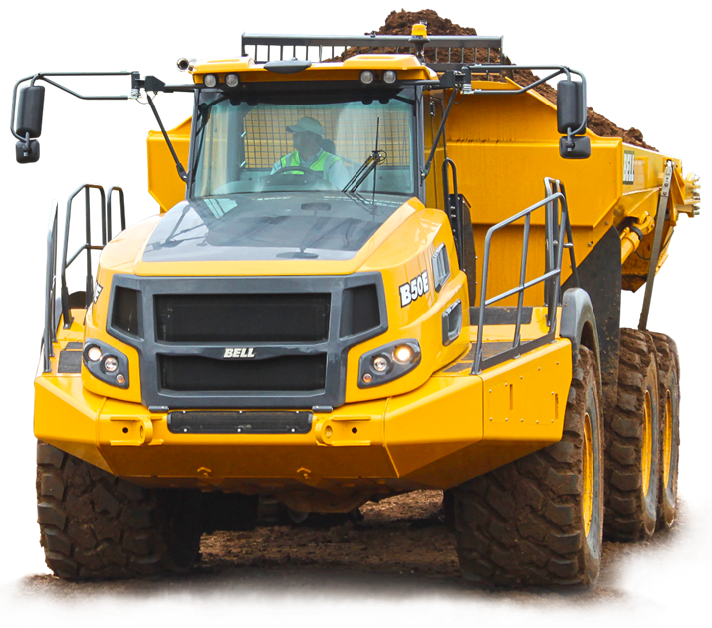
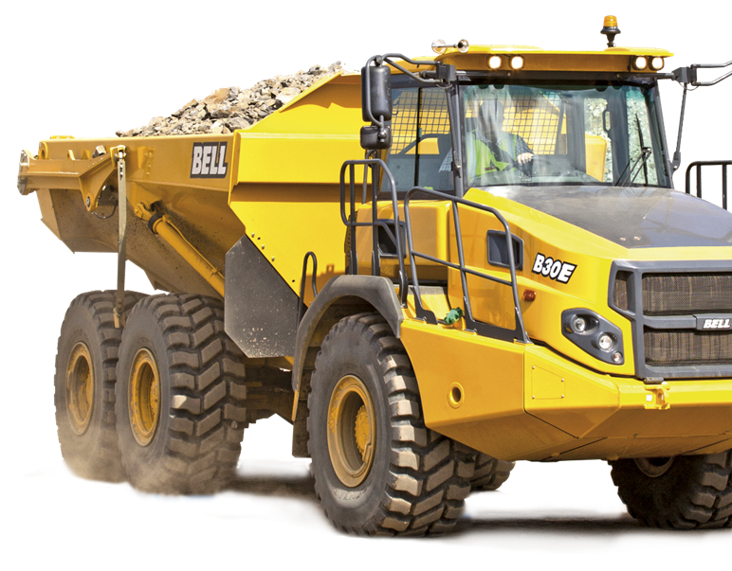
INFORMATION

Slide 2

BTA Help
Bell Equipment SSO

Slide 3
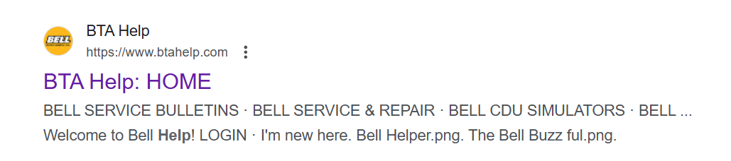

INFORMATION
https://www.btahelp.com/

Slide 4
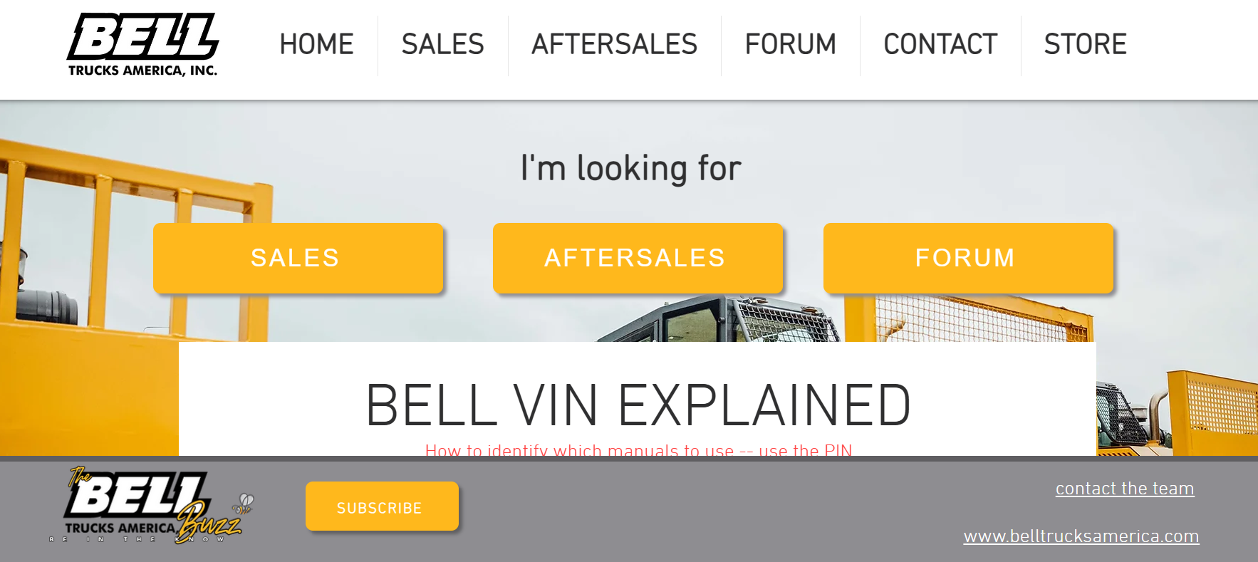
INFORMATION
https://www.btahelp.com/

Slide 5
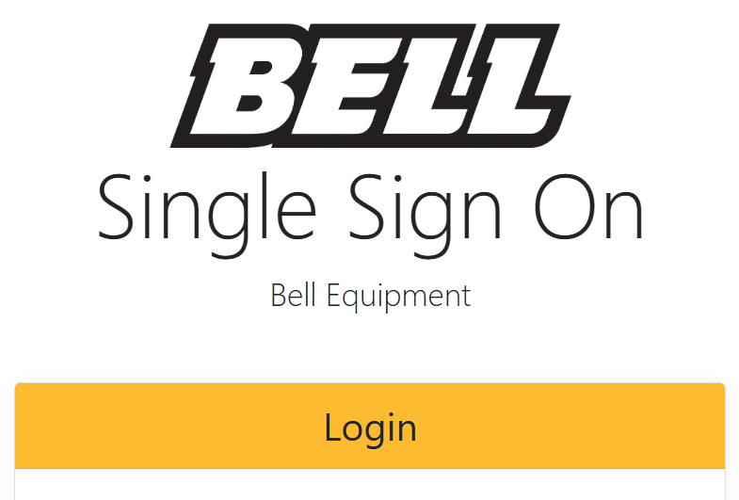

Slide 6
Video clip that explains registration process.
https://fleetmatic.bellequipment.com/ssoRegistration/story.html
Or you can go directly to the Bell business portal and register.
https://business.bellequipment.com/

Slide 7
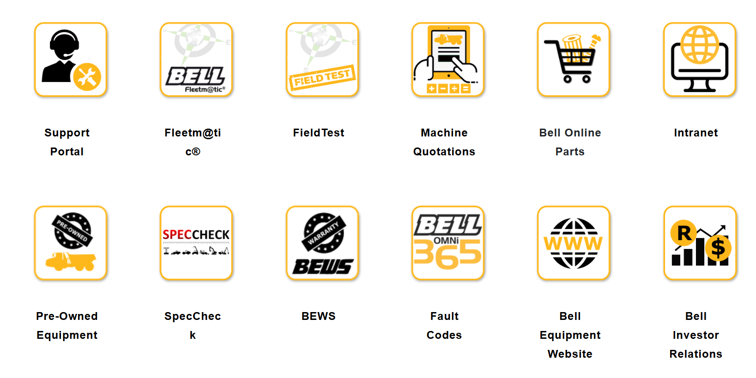

Slide 8
