Slide 1
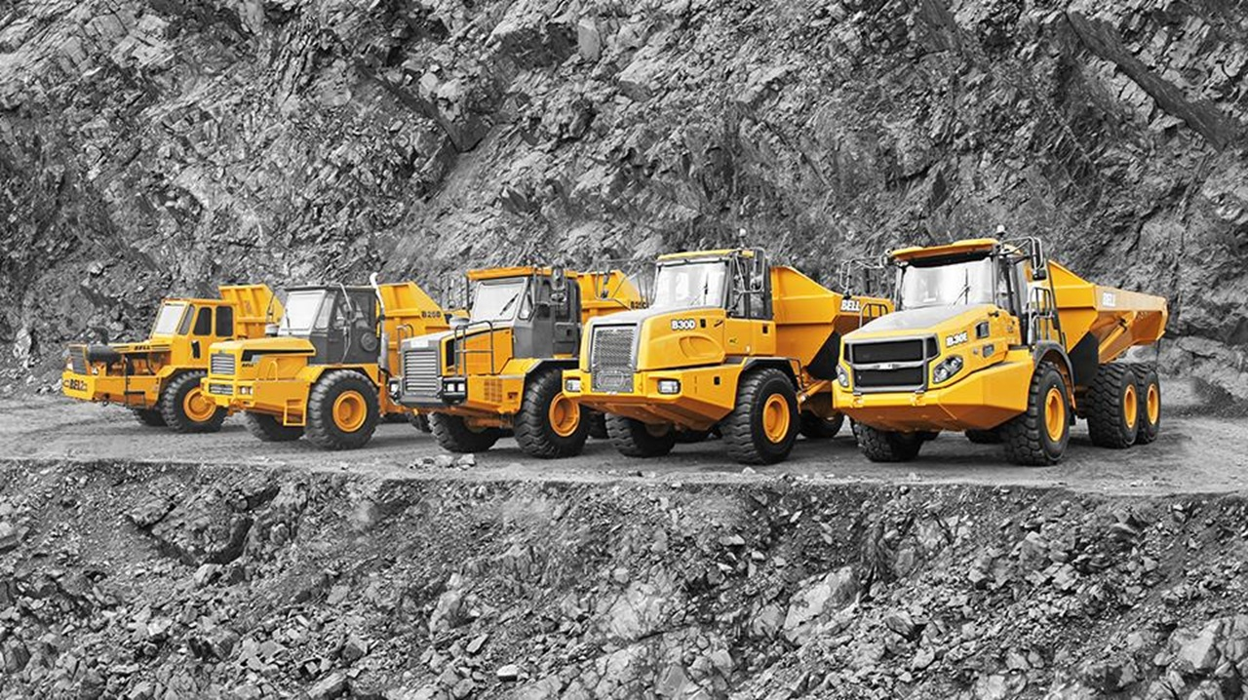

FLEETM@TIC

Slide 2

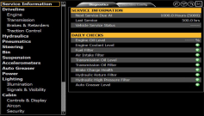
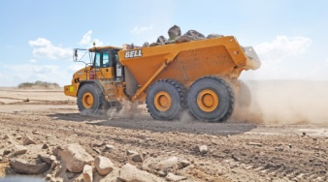

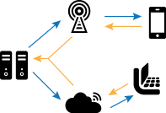
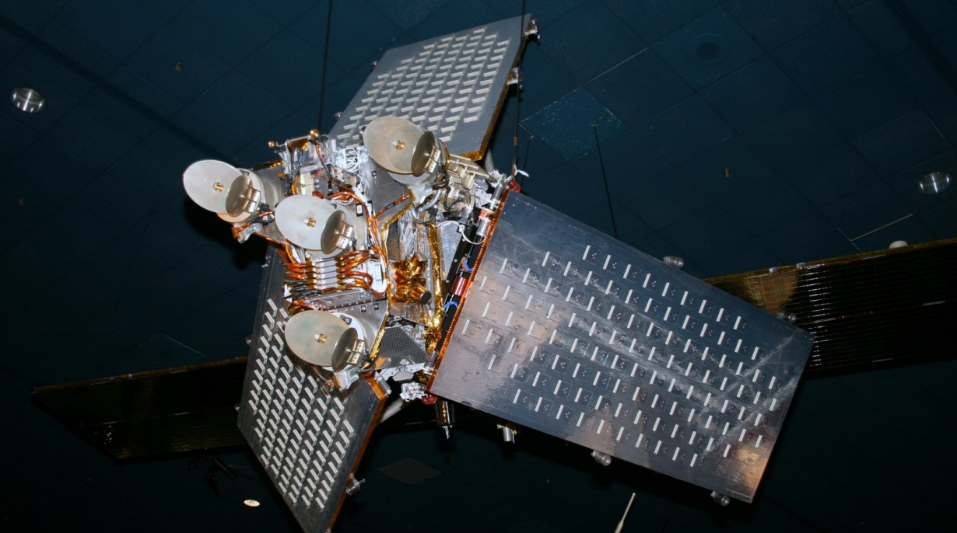
Fleetm@tic is what you get when you combine:
Global Positioning System
On Board Weighing that is accurate to +- 2%
Iridium Satellite Data Communication
GPRS Cell phone Network
Machine diagnostics

Slide 3
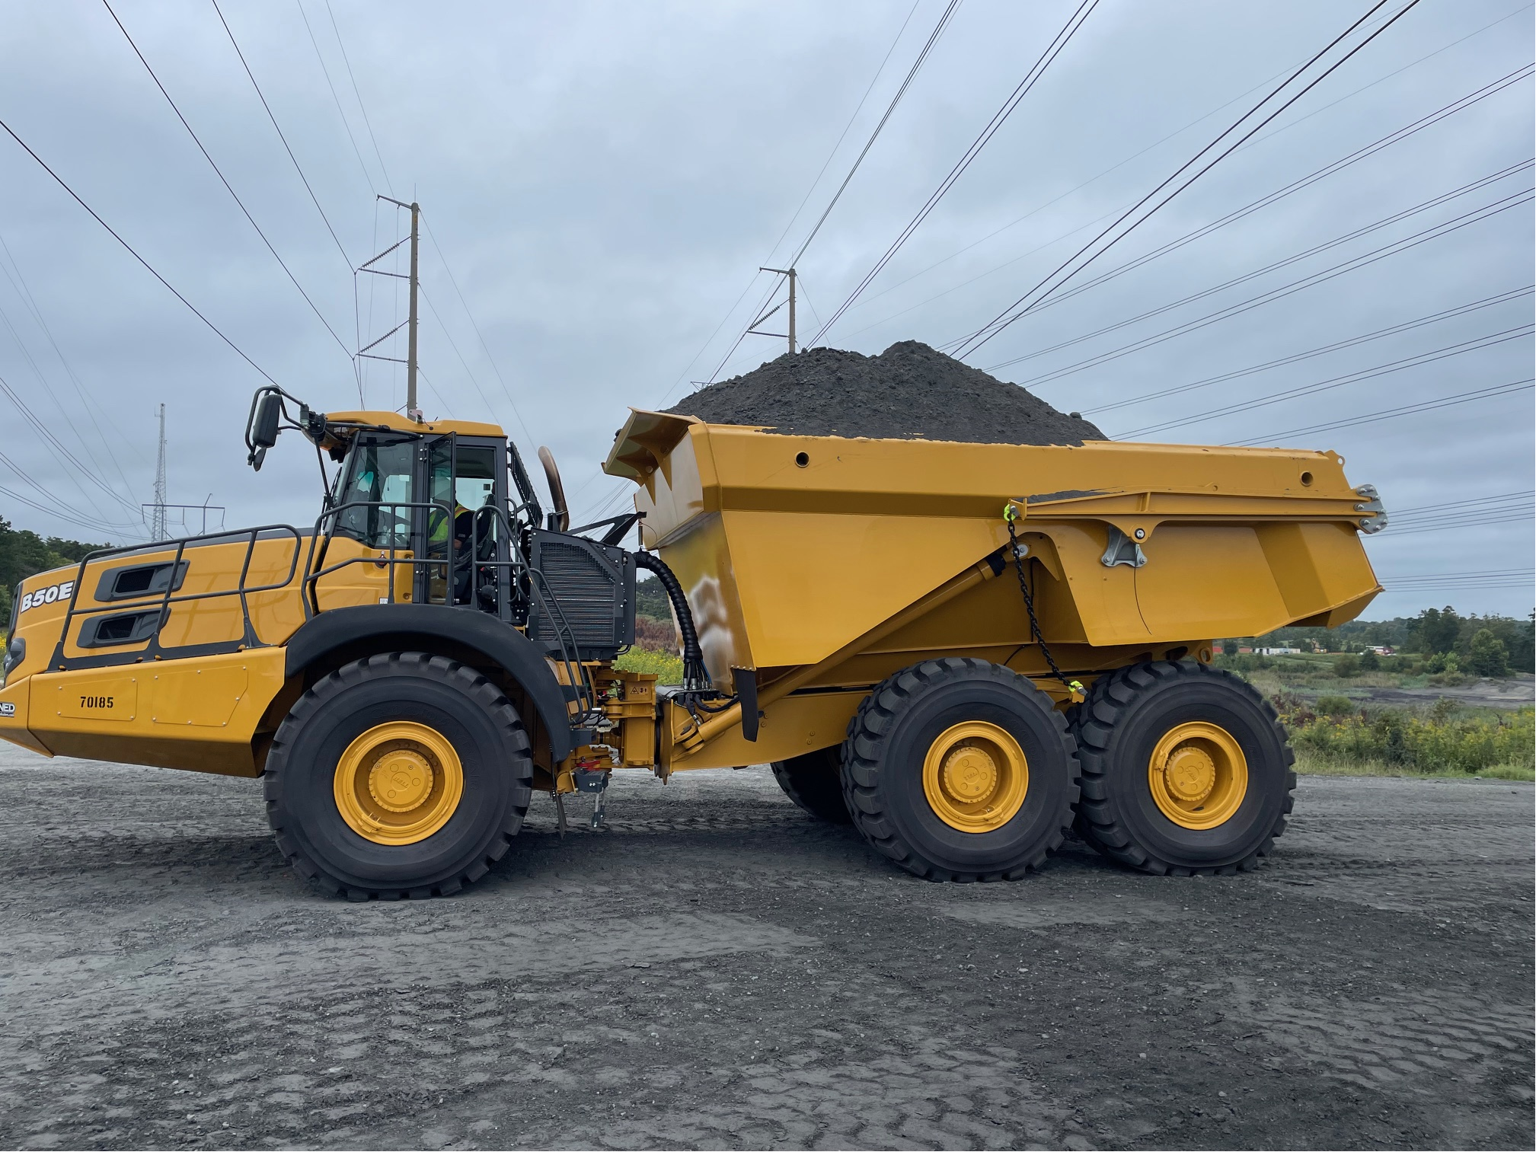
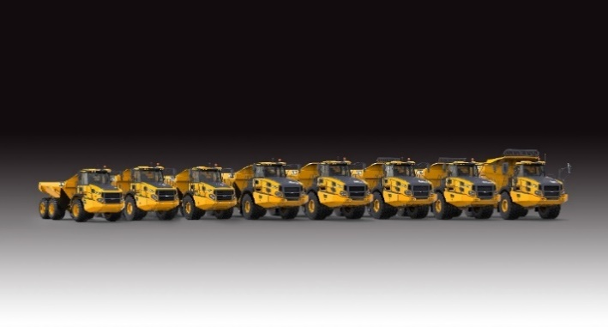
The Bell Asset Management Tool:
Helps you make the most of your investment
  Machine Productivity (How much money is your machine making you )
  Machine Utilization (Could your machine be making you more money)
  Machine Condition (How much longer will your machine be making money?)

Slide 4
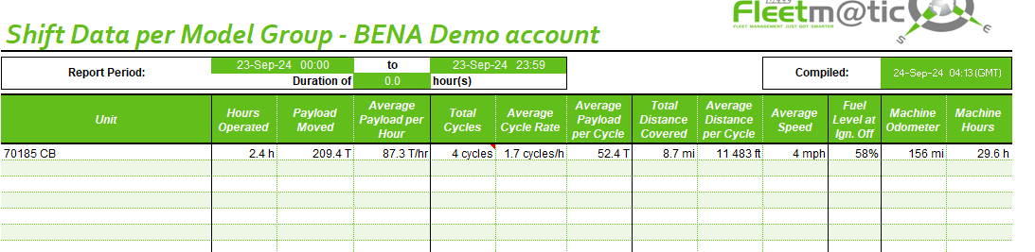
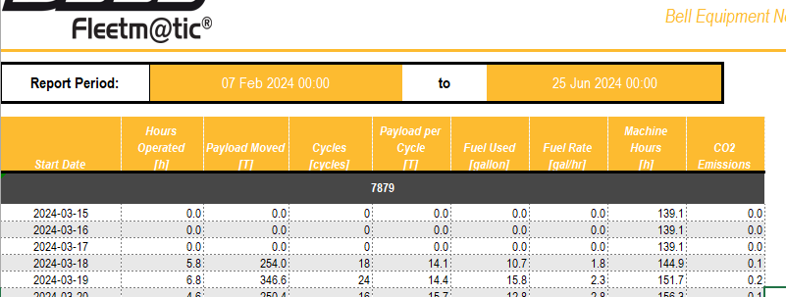
    Your Data:
Is available to you:
  Email reports with customizable report”.
  Live website.
  Export selected Data to pdf or excel
  Data download to your database. Has been given a format that meets the new telematics standard AEMP (ISO 15143-3:2016)
  If all machines supply telematics data according to this standard, then a customer with a range of product brands can view data from all his machines with one analysis program.

Slide 5
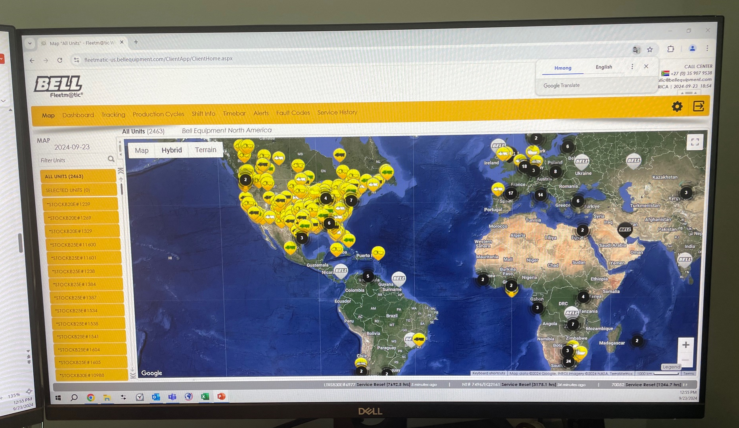
    Packages Available:
  The Classic package supplies you with enough information for you to have a very good understanding of how your machine is operating for each shift that it runs.- 60 months
  The Premium package is focused on customers who need to have extremely detailed information of the machine’s operation. For this package we offer similar information to that of the Classic package but for each individual laden – unladen cycle. In addition, live tracking is available on the Fleetm@tic website on a per minute basis.
FLEETM@TIC

Slide 6
    Machine Productivity:
  Cycles
  Tons moved
  Fuel burned

Slide 7
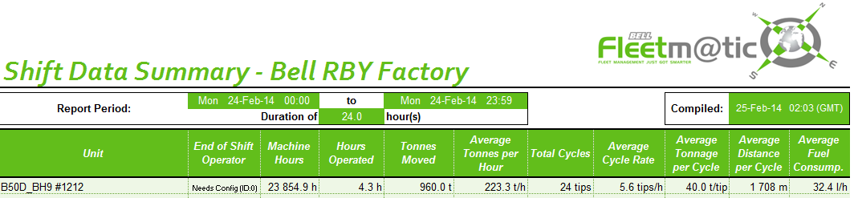
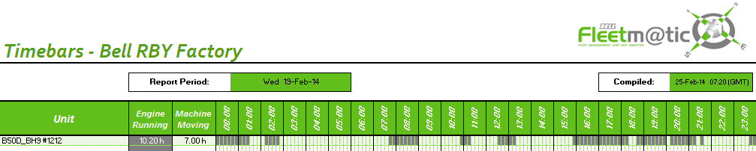
    Machine Utilization:
    Machine Loading (overloaded / underloaded)
  Idle Time
underloaded

Slide 8
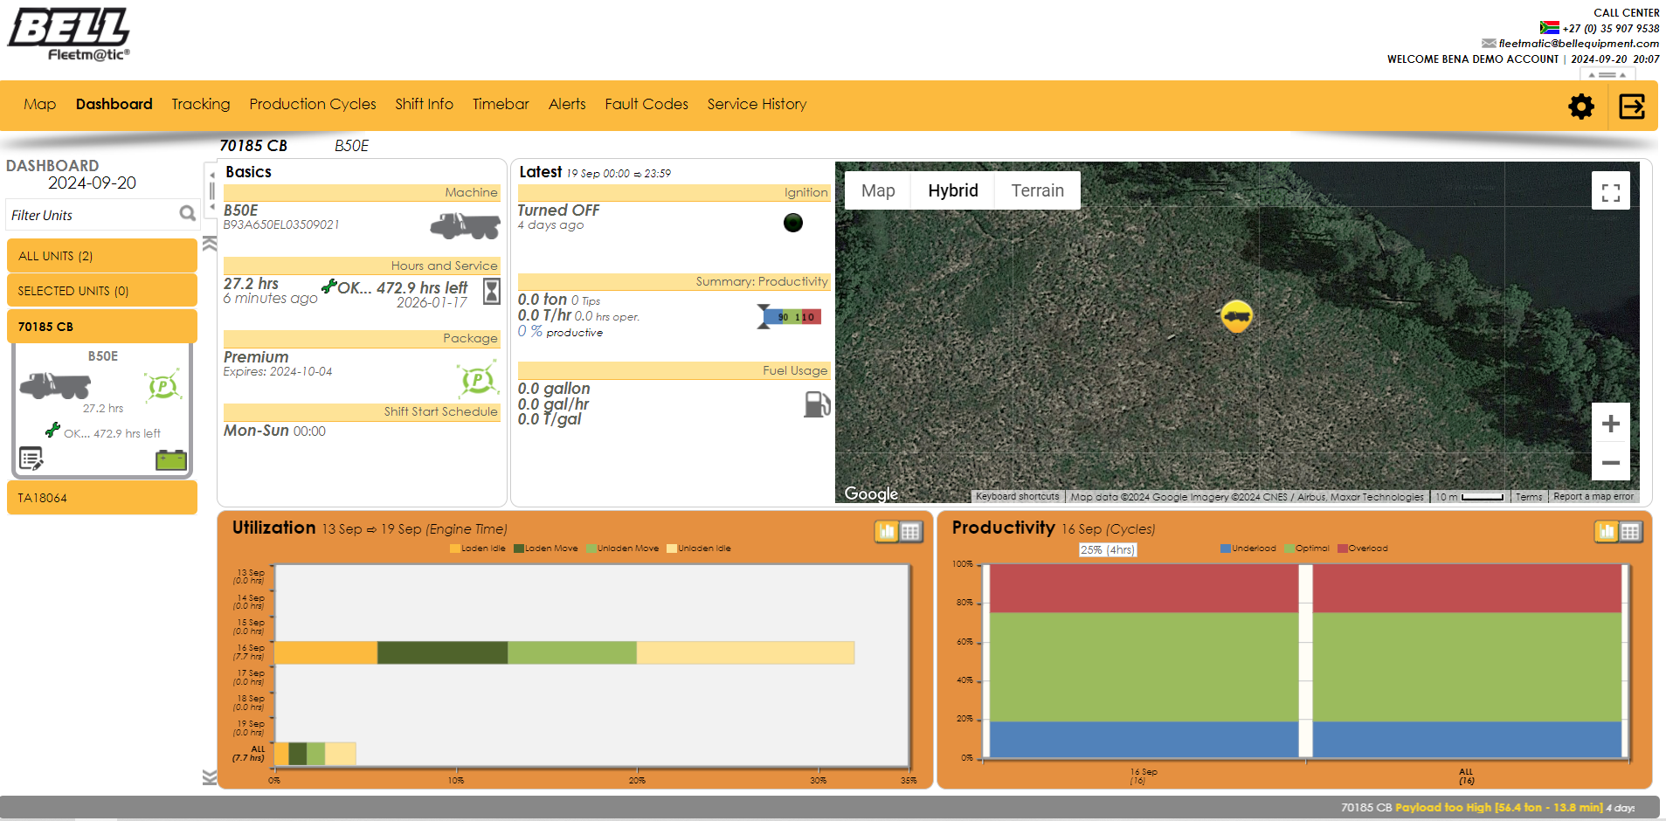
    Machine Productivity & Utilization – Live Website:
  Utilization Graphs (machine running hours).
  Productivity graphs (load capacity).
  Service indicator.
  Live productivity information.
  Minimap (loads & tips).

Slide 9
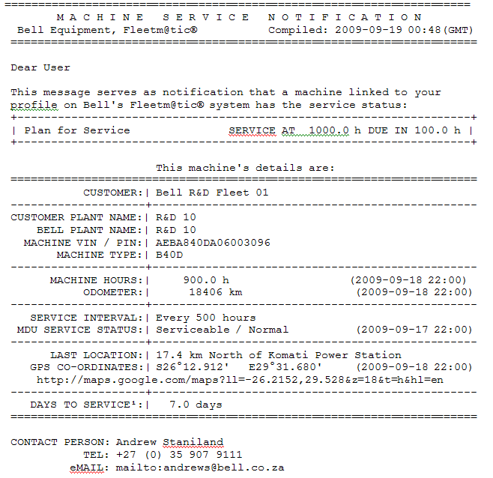
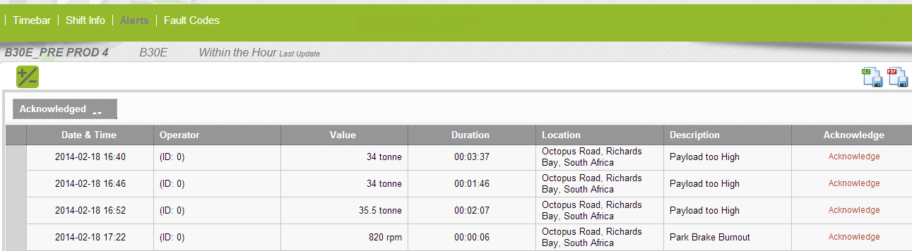
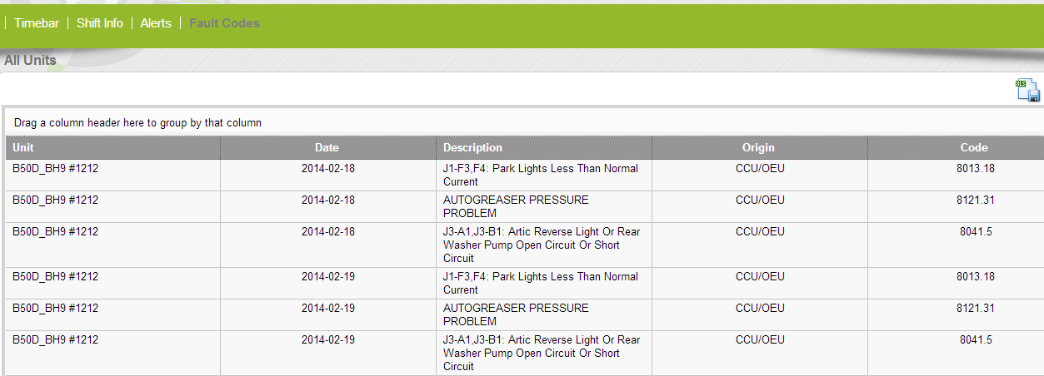
    Machine Condition:
  “Service Due” notification emailed to you and the nearest Bell dealer.
  Operational alerts: overloads, driver abuse etc. emailed to you only.
  Machine fault codes emailed to you only.

Slide 10
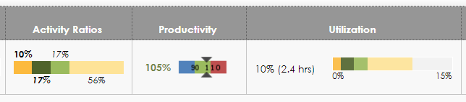
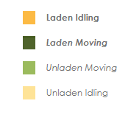
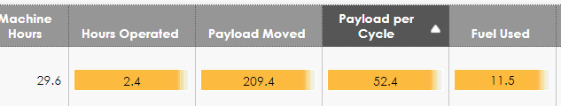
Activity Ratio – Ratio of hours operated to time spent doing activity
Laden idling 0.2 hr.
Laden Moving 0.4 hr. - (17% of working day)
Unladen Moving 0.4 hr.
Unladen Idling 1.4 hr. - (56% of working day)
Productivity – All about payload - % of rated payload
Want to be between 90% and 110%
Utilization
You machine is available 24 hours a day. How did you utilize your machine in that time?
Laden idling 1%, Laden moving 1.7%, Unladen moving 1.7%, Unladen idling 5.6%
Worked for 10% or 2.4 hrs. out of 24 hrs.
15% unused – running portion of shift

Slide 11
Questions?

