Slide 1

Then Worlds most advanced ADT:
Sealed Switch Module
&
B-Drive

Slide 2





E-series SSM Guide
The fully sealed switch module allows for simple operation as well as innovative programming between functions… Vehicle security is assured with only authorized codes allowing for start.
The B-Drive allows for quick navigation and selection of screens and settings on the monitor…

Slide 3
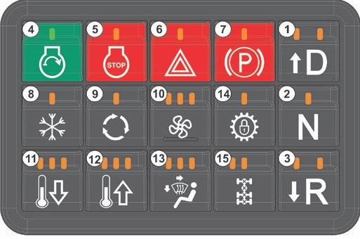
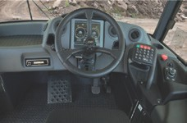
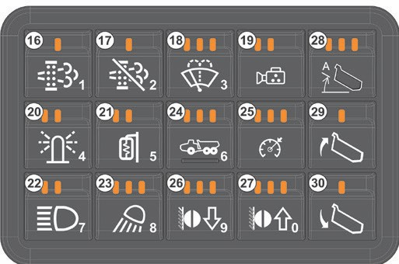
E-series SSM Guide
SSM1
SSM2

Slide 4
E-series SSM Guide
Drive button
Neutral button
Reverse button
Ignition On / Engine Start button
Ignition Off / Engine Stop button
Hazard button
Park Brake button
Air Conditioner button
Air Recirculation button
Blower Fan Speed button
Semi-climate Control (HVAC) (decrease temperature)
Semi-climate Control (HVAC) (increase temperature)
Air Direction button
Gear Hold
Interaxle Lock / Differential Lock button (CTD fitted to B35E - B50E ADT models)
SSM1

Slide 5
E-series SSM Guide
Manual Regen
Disable Regen
Front Wiper Control button
Reverse Camera*
Beacon Light
Electric Mirror Defrost button*
Head Lights
Work Lights
Machine Presets
Speed limit
Retarder Down
Retarder Up
i-Tip
Bin Up button
Bin Down button
SSM 2

Slide 6
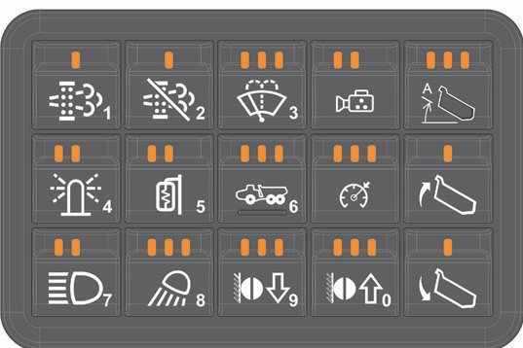
E-series SSM Guide
Use the numerical pad on the SSM to input any numbers requested by the CDU…
These include the security code and codes to enter service mode…
Alternatively, use the B-Drive Controller.
Under normal operator mode, the buttons revert back to their original
functions…

Slide 7
E-series SSM Guide
Differential Lock button
A short press and release of the “Differential Lock” button, when all LEDs are off, will cause the Inter Axle Differential Lock (IDL) to be applied and the left LED to illuminate.
Another quick press and release of the button when the left LED is illuminated will cause the IDL to be turned off.
A long press and release of the “Differential Lock” button when all LEDs are off, will cause the IDL and Controlled Traction Differential Lock (CTD) to be applied and both the LEDs to illuminate… After 30 seconds the CTD will be deactivated and the right light will go off…
The CTD is fitted on the B35E - B50E 6x6 ADT models and only on the front axles of the 4x4 ADT models… IDL and CTD will only engage at speeds less than 1 mph. The CDU will show the status of the IDL and CTD…

Slide 8
E-series SSM Guide
Transmission Gear Selection and Range Select button (Drive-Neutral-Reverse)
Drive/Reverse
Select “D” or “R”…
Press “Park Brake” button to release the park brake (LED and the CDU park brake indicators will go off)… Drive off…
Neutral
If “N” is pressed and the machine’s speed is less than 2 mph, then the park brake will be automatically applied. Park brake will be released after “D” or “R” selected
To manually change the maximum gear that can be attained, Press the or arrows (also “D” and “R” ) when the transmission is in Drive mode and the left LED above the “D” is on (around 3mph)
The maximum current gear is displayed in the middle of the CDU, by two numbers.
The RHS number is the highest gear that can be attained… The LHS number is the current gear. The or arrows control the LHS numbers

Slide 9


E-series SSM Guide
Speed Control buttons
This function allows the operator to set the maximum speed for the truck, thus allowing him to have accelerator pedal completely depressed without having to worry about controlling the speed or worrying about foot movement from bumpy roads.
The speed control function mimics an operator by reducing accelerator and applying the retarder. First LED is Production Speed Limit 1 and Second LED is Production Speed Limit 2… The speed limit can be increased or decreased using the retarder up or down button For operator safety it is advised that the speed control values be set while the machine is stationary.

Slide 10
E-series SSM Guide
Retarder / Speed Control buttons
Retardation
The retarder comes on automatically when your foot is lifted from the accelerator pedal.
To set the retarder aggressiveness press the or arrows…
Engaging the retarder helps to control the speed of the truck especially during descent. It also is a factor in reducing fuel consumption and minimizing brake wear.
The retarder settings are:
0 x LED
1 x LED
2 x LED
3 x LED
4 x LED
5 x LED
6 x LED
=
=
=
=
=
=
=
15%
25%
35%
45%
60%
75%
100%
Downhill Speed Control
The retarder will automatically activate at the pre-set level as soon as the operator takes their foot off the accelerator pedal… However, if the truck goes faster than the speed it was doing when the operator took their foot off the accelerator, the retardation will automatically be increased to prevent the truck from running away… This feature can be turned off…

Slide 11
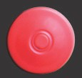

E-series SSM Guide
Emergency Stop Button
This button is only to be used in an emergency. When depressed the accelerator will be disabled. Functions will cease immediately. The park brake will be immediately applied. The transmission will be put into Neutral after the speed drops to below 3mph…
STOP
ENCY _{E}R^{G}
S _{M} T
_{E} ^{O}
P
^{P}USH
The CDU will display an “Emergency Stop” message.
To cancel the “Emergency Stop” (and regain production and driving controls) the button will have to be reset.

Slide 12


E-series SSM Guide
Automatic Park Brake Application
When neutral is selected, automatic park is activated… The automatic park brake helps to stop the machine’s movement and keeps it stationary even on a slope…
The park brake is automatically applied when neutral is selected, and the vehicle speed is less than 5km/h… The park brake is automatically released when a gear is selected,
and the required engine torque is reached… It is not possible to engage neutral at high speeds…
AUTO

Slide 13
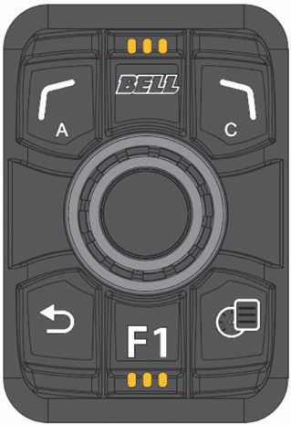
E-series SSM Guide
B-DRIVE
01
02
03
01 - Back and Soft Key Button
02 - Bell Button
03 - Forward and Soft Key Button
04 - Back Button
05 - Menu Button
06 - Rotary Knob
07 - F1 Button: Reserved for future use
06
04
07
05

Slide 14



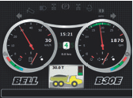


E-series SSM Guide
On Board weighing
Overloading a dump truck exceeds the load rating of its tires and braking system, extending the vehicle’s total stopping distance. The vehicle also becomes unstable and is prone to tipping over.
To prevent overloading, Bell ADTs come standard with real-time load information. Load lights communicate with the loading tool operator to indicate when a vehicle is fully loaded, and overloaded vehicles are made visible by load lights.
If the vehicle is overloaded, there is an option to reduce speed, and the driving parameters will automatically adjust to compensate for the load.
Fleetm@tic® sends load data to the machine’s owner…

Slide 15
E-series SSM Guide
Automatic Hill Descent Control
Engine braking and retardation is varied automatically to maintain the speed at which the operator takes their foot off the accelerator. This will prevent the machine from accelerating downhill.
Hill Hold (B30E to B60E)
If the operator releases the accelerator pedal while driving uphill, the brakes will automatically apply to prevent an unsafe roll back. When the operator accelerates again, the brakes are automatically released.
Site specific Geofencing
A circular geofence can be manually setup on the machine. When the machine enters or leave this area, a speed limit can be activated.
Effective Retardation
A constant six-wheel drive system ensures the safest retardation possible without relying on driver judgment. Excess capacity to safely control load is ensured by engine and brake retardation. Even on the steepest slopes, a loaded vehicle can be easily controlled using the retarder.

Slide 16
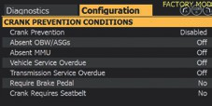
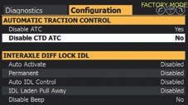

E-series SSM Guide
Effective Retardation
A constant six-wheel drive system ensures the safest retardation possible without relying on driver judgment. Excess capacity to safely control load is ensured by engine and brake retardation. Even on the steepest slopes, a loaded vehicle can be easily controlled using the retarder…
Automatic Traction Control (ATC)
ATC is standard on all Bell E-series ADTs, but it can be turned off at the customer’s request.
Traction control is an active safety feature that assists in maintaining traction between the tires and the road when conditions are slippery or dangerous.
When the machine detects slippage, the safety feature engages the inter-axle differential lock (IDL) to maintain traction. This will split the drive 50/50 front and rear.
AUTO

Slide 17
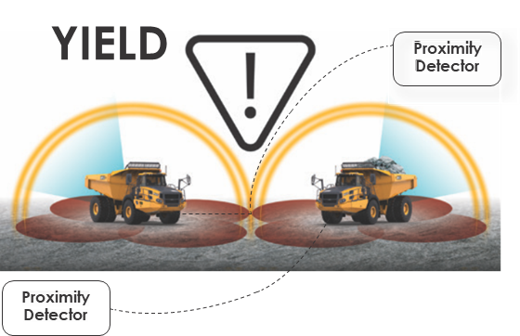
E-series SSM Guide
Proximity Detection System (PDS) / Collision Avoidance System (CAS)
Bell ADTs are PDS/CAS ready.
Proximity detection systems improve the operator’s awareness by detecting possible collision threats and warning the operator visually and audibly.
Collision avoidance systems intervene with a vehicle by either slowing it down or stopping it to prevent, or at least minimize, the severity of collisions between equipped vehicles and equipped pedestrians.
As an option, the PDS gateway is available, and the customer can install their preferred third-party PDS (provided it was tested using the Bell simulation system)
If the PDS is faulty, there are options to prevent crank or tip. There are also speed limit options available in the event of a PDS failure…

