Slide 1

WALK AROUND HIGHLIGHTS

Slide 2
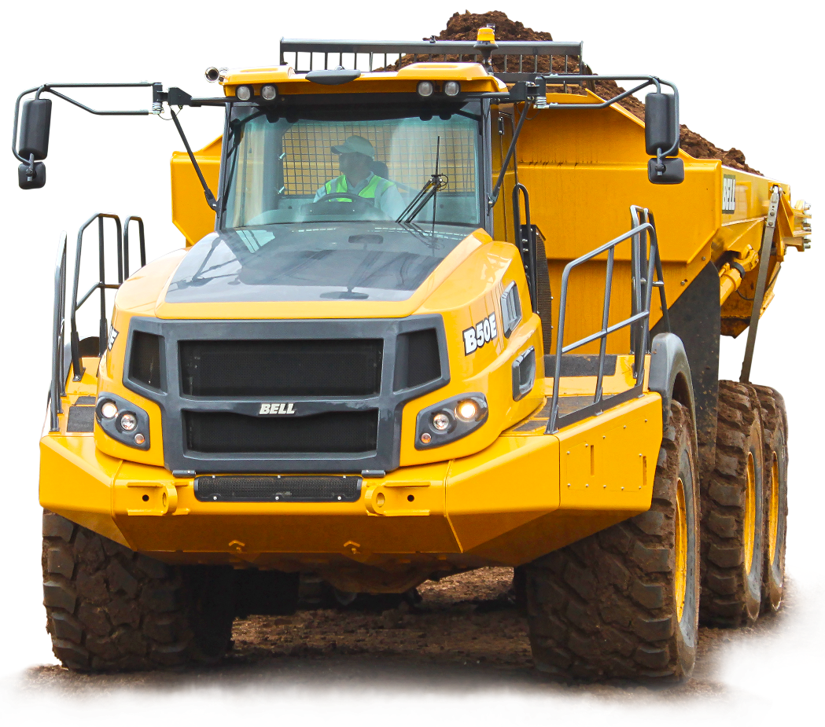
WALK AROUND HIGHLIGHTS
POWER-TO-WEIGHT RATIO
Industry leading engine power-to- weight ratio
MERCEDES BENZ & ALLISON
Mercedes Benz engines and Allison transmissions achieve maximum performance with exceptional fuel efficiency
CONTROLLED TRACTION DIFFERENTIALS (B40E to B60E)
Part of our automatic traction control (ATC) system, when loss of traction is detected the clutch pack is automatically closed to transfer torque from one side of the axle to the other
B20E to B30E - LSD
TRANSFER CASE.
Splits torque in proportion to the axle loading to maximize off-road performance… The inter-axle diff lock is part of the automatic traction control (ATC) system and is locked.
Filtered and Cooled
FRONT SUSPENSION
Leading A-frame suspension with hydro-pneumatic struts ensures best off-road ability with maximum comfort…
Adaptive suspension available as an option on B30E and B45E

Slide 3
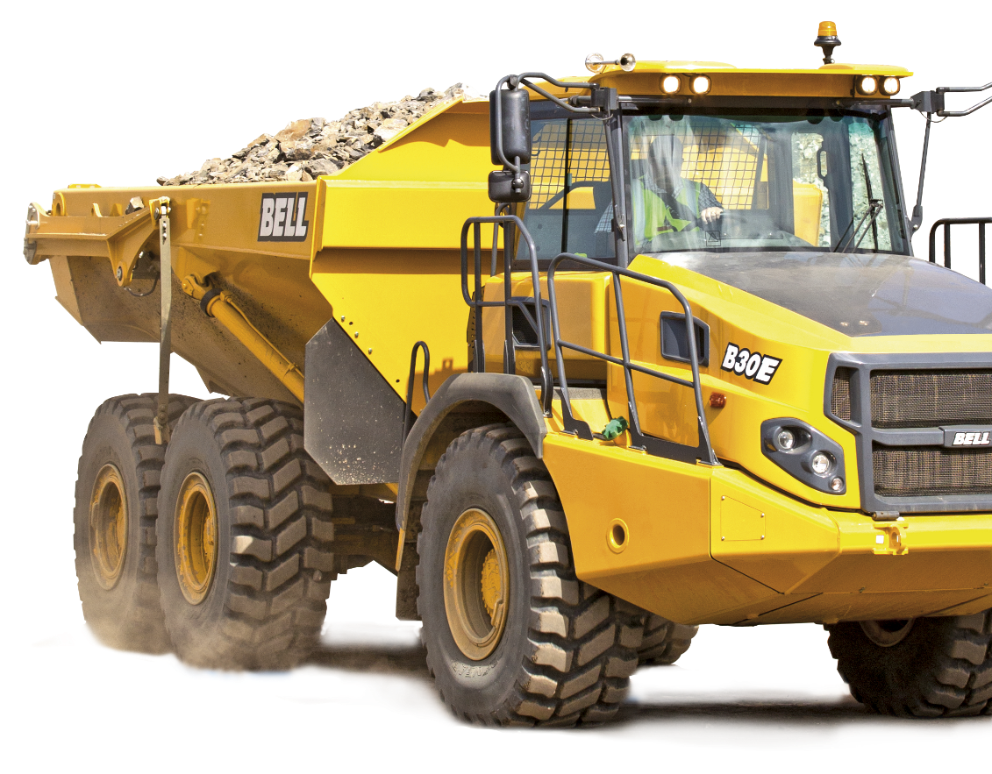
WALK AROUND HIGHLIGHTS
RETARDATION
The B20E engine braking is provided by EVB and exhaust brake.
Engine braking on the B25E is provided by EVB and exhaust brake combined with a transmission retarder…
The B30E combines EVB and exhaust brake with automatic activation of the
wet brakes…
On the B40E to B60E
engine braking is provided by a Jacobs Brake® combined with automatic activation of the wet brakes…
STRENGTH-TO-WEIGHT
Right sized fabricated axles provide the highest strength without compromising on dead weight
MAXIMUM TRACTION
For sites with a difficult pull-away, the machine can be configured to engage the inter-axle diff lock for every laden pull-away
REAR SUSPENSION
Proven rear walking beam concept delivers best-in-class axle travel to keep wheels
on the ground
LIMITED SLIP DIFFERENTIALS (B20E to B30E)
Automatically transfer torque from one side of the axle to the other in the event of loss of traction on a side
ALLISON TRANSMISSION
Planetary transmission minimises torque interruption during shifts for smooth uphill operation… Shift point optimisation accounts for machine load and operating conditions… B18E to B30E have 6 speed transmissions while the B40E to B60E have 7 speed

Slide 4
Operation Highlights – simplified.
The Bell ADT has;-
Rollover protection alerts operators to unsafe dump angles and stops the dump cycle.
Downhill dump protection automatically calculates ADT position, so the dump body doesn’t move over-center when emptying downhill.
With auto tip, park brake enabled, and driveline assist activated.
With hill hold, the service brakes automatically apply when the ADT is stopped on an uphill slope preventing backward machine rolls.
Frame protection cushions bin travel back to the cradle, preventing aggressive frame seating and operator discomfort
With shuttle shifting, the transmission may be shifted from Forward to Reverse without the ADT coming to a stop, improving cycle times and eliminating operator abuse.
Descent control helps regulate ADT speed when driving down a descent through automatic use of the wet disc brake and engine retarder.
Dump-body limits can restrict maximum dump height when low overhead obstacles are encountered.
Maximum speed limit can be set to match jobsite conditions or requirements, reducing operating complexity.
Overload frame and bin protection

Slide 5
Operation
AUTOMATIC TRACTION CONTROL (ATC)
The ATC system combines information from a number
of on-board sensors to identify when the machine is on slippery ground… The interaxle diff lock and controlled traction differentials (B35E to B60E) are then
automatically activated as they are needed
i-Tip
This tipping function automatically activates the park brake, selects neutral, tips the bin and revs the engine to safely give maximum productivity
TIP SAFE
This function prevents the bin from tipping if the rear chassis is leaning over by more than a pre-set value
FLEETM@TIC ®
Fleetm@tic allows for full desktop control helping you identify areas in your operation for process improvement to lower costs… The Classic package is standard on the truck for 5 years while Premium is available on subscription
DOWNHILL SPEED CONTROL
Engine braking and retardation is varied automatically to maintain the speed at which the operator takes their foot off the accelerator

Slide 6
Operation
SPEED LIMITS
Both operator and overall site speed limits can be set up that accurately limit speed through de-activation of accelerator pedal and automatic retardation
HILL HOLD
When driving up a hill, if the operator releases the accelerator pedal the brakes
will automatically apply to prevent unsafe roll back… Brakes are automatically released when the operator accelerates again When pulling away on an incline, the automatic park brake is only released when there is enough torque to prevent the machine from rolling backwards
AUTOMATIC PARK BRAKE
When neutral is engaged a truck is at risk of running away… A Bell ADT automatically applies the park brake to keep it safe and automatically releases it when Drive is engaged, and the accelerator pedal is pressed
ENGINE PROTECTION
Turbo spin down function is fitted as standard. Automatic shutdown can also be activated to stop the engine after excessive idle has been registered

